Slide 1
Real Estate Across the United States (REXUS) Lease Data
Group 2
Erica Wollmering
Ally Eveslage
Connor Beaton
Noah Stevenson
Derek Bates
Notes:
Erica
Slide 1: Project Introduction
Talking Points:
Good evening, everyone. On behalf of our team, we are excited to present our project, REXUS Lease Data.
My name is Erica, and alongside my teammates Ally, Connor, Noah, and Derek, we've undertaken a deep dive into federal property management and its efficiency.
Our project aims to shed light on how government properties are utilized and explore opportunities for improvement in cost and efficiency.
Our analysis is based on the Real Estate Across the United States (REXUS) datasets, which include detailed data on federal building inventory and leasing information.
This dataset is from data.gov

Slide 2
Our Objectives
Government Efficiency
Space Management
Cost Savings
Transparency & Accountability
Where, in the US, are the most government leased properties?
What if, any, are the correlations between:
rent amount and usable ft²?
usable and rentable ft²?
rent amount and parking spaces?
ZIP code and length of lease?
rent amount and ft² of unit leased?
ZIP code and rent of unit leased?
Notes:
Erica
Slide 2: Our Objectives
Talking Points:
Small blurb about government leased buildings:
Office space: The U.S. General Services Administration (GSA) leases office space to federal agencies, including the Department of Agriculture, the Social Security Administration, and the Federal Bureau of Investigation.
Warehouses: The GSA leases warehouses to meet the needs of federal agencies
Detention centers: The Office of Refugee Resettlement leases property to house unaccompanied children in federal custody.
Military installations: The GSA leases military installations to meet the needs of federal agencies
Courthouses: The GSA leases courthouses to meet the needs of federal agencies.
Post offices: The GSA leases post offices to meet the needs of federal agencies
Data processing centers: The GSA leases data processing centers to meet the needs of federal agencies
Our project aims to answer the key questions shown on the left to help achieve the broader objectives listed on the right.
By analyzing correlations between factors such as rent amount, usable square footage, and parking spaces, we can provide actionable insights to optimize property utilization.
Specifically, our objectives include:
Government Efficiency:
Analyze and optimize government property usage.
Reduce costs associated with owned and leased properties.
Space Management:
Help federal agencies improve space allocation and resource utilization.
Identify underutilized or surplus properties for better reallocation.
Cost Savings:
Evaluate lease versus ownership costs to identify cost-saving opportunities.
Spot trends in lease renewals, terminations, and rent escalations.
Transparency & Accountability:
Provide transparency into federal property management for oversight and public trust.
Allow agencies and watchdogs to track government spending on real estate.
These objectives form a strong foundation for broader efforts in federal property management reform, paving the way for efficiency and accountability.

Slide 3
Data Cleaning: Part 1
Initial Dataset
Started with 7,582 rows , 19 columns and removed 9 irrelevant columns.
Country Filter:
Filtered all data by country and kept only US data , cleaned state names (e.g., "Illinois" to "IL").
Surface Parking:
Binned Surface Parking Spaces into the categories
Small (0–49), Large (50–99), XLarge (100–249), and Jumbo (250–5000).
ZIP Code Processing:
Standardized ZIP codes to 5 digits by truncating or adding leading zeros.
Created a new column "Regions" by binning ZIP codes using predefined ranges and labels.
Notes:
Connor
We removed all countries except the USA and cleaned up the state names (e.g., changed “Illinois” to “IL”) while retaining US territories. This reduced the dataset to 7,576 rows of data.We renamed the columns to more efficient names. We described surface parking and binned it into the following categories:
Small (0–49)
Large (50–99)
XLarge (100–249)
Jumbo (250–5000)
We created a new column called "Regions" by grouping ZIP codes into predefined bins. Using the pd.cut() function, we categorized each ZIP code into one of the regions. Before binning, we converted ZIP codes to float64 because pd.cut() requires numerical data. After binning, we converted them back to strings for categorical use. The zipbins list defined the ZIP code ranges, and group_zipnames assigned region labels to each range.We cleaned up ZIP codes with 9, 8, 7, and 4 digits by splitting and standardizing them into 5 digits (e.g., using the first 5 digits and adding leading zeros when necessary).

Slide 4
Data Cleaning: Part 2
Date Conversion:
Used a custom function to reformat dates from "DD-MON-YY" to "YYYY-MM-DD".
Converted lease start and end dates to datetime format for calculations.
Computed length of lease (days) and binned them into Short, Medium, Long, and Very Long categories.
State Grouping:
Added a category for "Top States" and "Other" for visualization purposes.
Dropped Irregular Rows:
Removed rows with invalid ZIP codes for PR and VI.
Final Dataset:
The dataset in its cleaned state has 7,400 rows and 15 columns.
Output:
The cleaned data was then exported to a CSV file.
Notes:
Connor
We created a function to convert dates from "DD-MON-YY" to "YYYY-MM-DD". The function split the input string, ensured the day had two digits, mapped the month abbreviation to its corresponding number, and prefixed the two-digit year with "20" to convert it to four digits. The reformatted date was returned as a string in "YYYY-MM-DD" format.
We looped through the rows and converted the lease start and end dates using the previously defined to_form() function. The reformatted date strings were converted into datetime objects using pd.to_datetime() to facilitate calculations. We computed the difference between "End Date" and "Start Date" to determine the lease length in days.
We described the lease lengths and binned them into the following categories:
Short (0–999)
Medium (1,000–2,999)
Long (3,000–4,999)
Very Long (5,000–15,000)
We grouped states into "Top States" and "Other" for a pie chart. We noticed irregular ZIP codes for Puerto Rico (PR) and the Virgin Islands (VI) and dropped those rows, which totaled 11.
The final dataset contained 7,400 rows and 15 columns. We exported the cleaned dataset to a CSV file.

Slide 5
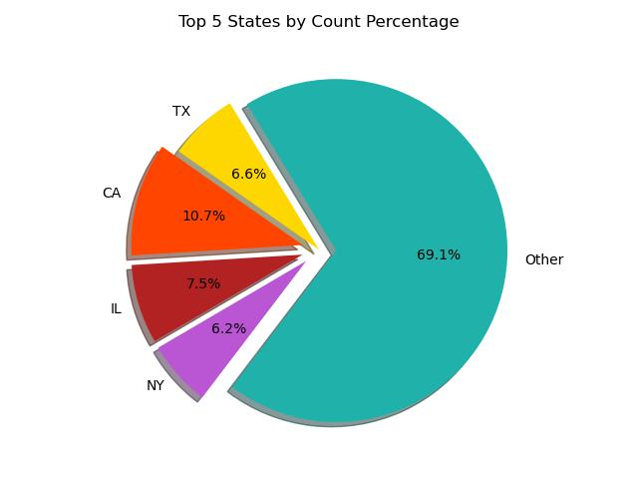
Within the United States, where is the highest population of government leased properties?
California is the most populated state in the US with 38.97 million people
CA has the highest population of government leased properties (10.7%) aside from Other (69.1%).
Notes:
Ally
As part of our analysis, we examined where the highest concentration of government-leased properties is located across the United States.
California, the most populous state with 38.97 million people and the third largest by land area, emerges as the leader, hosting 10.7% of all government-leased properties—the highest among individual states.
Beyond California, other states with notable concentrations of Government Leased buildings include Illinois, New York, and Texas, while 69.1% of properties are distributed across other states and territories categorized as "Other”, housing all other states within the US excluding New York, Illinois, Texas, and California. The other category also houses some US provinces.
Understanding these concentrations is critical for identifying opportunities to optimize resource allocation, reduce costs, and improve space management in these heavily utilized areas.

Slide 6
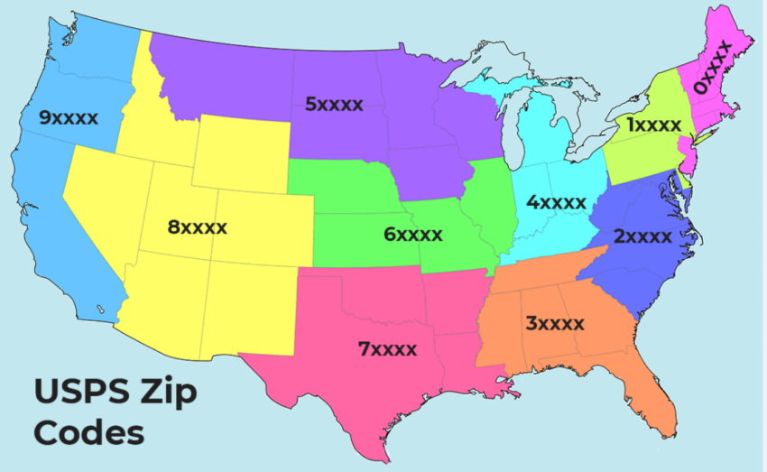
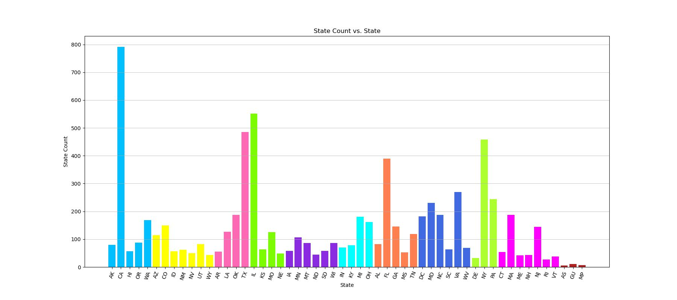
Notes:
Ally
This bar chart, alongside the Zip Code map located at the top right, we’re able to see the surrounding states of those who house the highest amount of leased buildings.
For most Zip Code locations, there tends to be one area which houses a large quantity of government leased buildings, rather than the buildings evenly distributed throughout the geographic area.
As stated in the last slide, we can see some influence from other locations such as American Samoa, Guam, and the Northern Mariana Islands located at the far right.

Slide 7
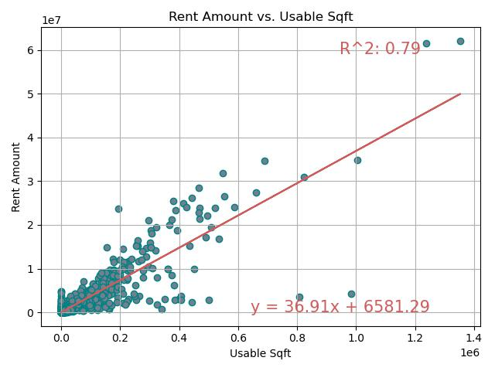
Is there any correlations between usable ft² in a lease versus the rent amount requested?
The R² value of 0.79 suggests a strong relationship between the two variables.
Notes:
Derek
Is there any correlations between usable ft² in a lease versus the rent amount requested?
*Read the R² value and first prompt!*
The R² value of 0.79 suggests a strong relationship between the two variables, meaning about 79% of the variation in Rent Amount can be explained by the Usable Square Footage.
This graph demonstrates that larger usable spaces tend to command higher rents, which is logical in real estate contexts.
Opportunity? Not much opportunity lies within this observation, as more usable square feet will likely always drive the rent price up.

Slide 8
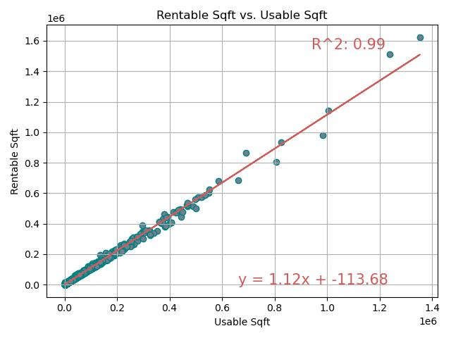
Is there any correlations between usable ft² in a lease versus rentable ft² in a lease?
The R² value of 0.99 indicates an extremely strong relationship between Usable Square Footage and Rentable Square Footage
Opportunity!
Notes:
Derek
Is there any correlations between usable ft² in a lease versus rentable ft² in a lease?
Info about usable versus rentable: Usable square feet" refers to the actual space a tenant can occupy within a building, while "rentable square feet" includes the usable space plus a portion of the building's shared common areas like hallways, lobbies, and restrooms.
(First portion is inside slide- continue on after the bolded section!)
The R² value of 0.99 indicates an extremely strong relationship between Usable Square Footage and Rentable Square Footage, meaning 99% of the variation in Rentable Square Footage is explained by Usable Square Footage.
This likely indicates that most usable space is rentable, and the small deviations might be due to space inefficiencies or other factors.
Opportunity: Evaluate properties with low usable square footage relative to rentable space. Renovations or repurposing could increase usable space and improve rental value.

Slide 9
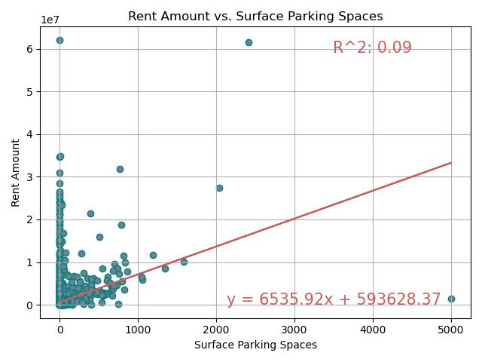
What are the correlations, if any, between rent amount and surface parking spaces?
The R² value of 0.09 indicates a very weak relationship between Surface Parking Spaces and Rent Amount.
Outliers!
Opportunity!
Notes:
Derek
What are the correlations, if any, between rent amount and surface parking spaces?
Only 9% of the variation in Rent Amount is explained by the number of Surface Parking Spaces.
This suggests that other factors are more influential in determining Rent Amount.
Outliers: One aspect to consider for further analysis is removing the outliers to observe how the R² value changes.
Opportunity: Consider reducing excess parking spaces in areas where parking demand is low. This could lower maintenance costs without affecting rent.

Slide 10
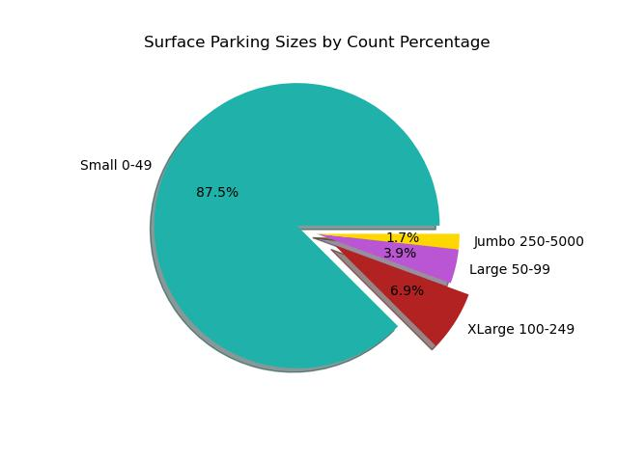
What is the distribution of parking space sizes?
Small 0-49 = 87.5%
Large 50-99 = 3.9%
XLarge 100-246 = 6.9%
Jumbo 250-5000 = 1.7%
Opportunity!
Notes:
Noah
What is the distribution of parking space sizes?
The exploded slices highlight the larger parking sizes for emphasis, making it clear that "XLarge 100-249" (6.9%), "Large 50-99" (3.9%), and "Jumbo 250-5000" (1.7%) constitute much smaller portions.
Opportunity: Evaluate whether these small lots meet tenant needs. If not, consider consolidating or re-allocating space for other uses (e.g., retail or storage) to increase revenue.

Slide 11
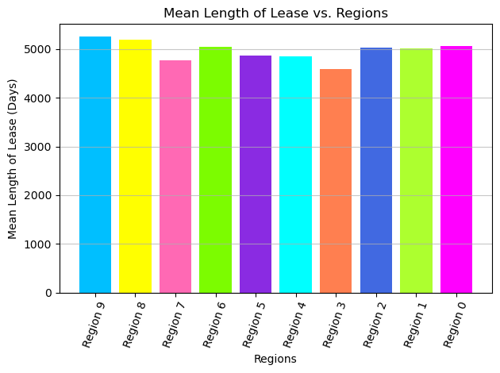
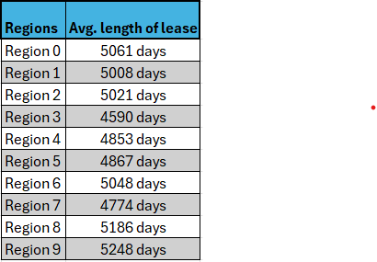

What are the distributions of the Zip Codes and the Lengths of leases?
5061 days
_
4867 days
5248 days
5008 days
4853 days
5186 days
5048 days
5021 days
4590 days
4774 days
The mean lease length across regions (approximately 5000).
There is no significant disparity between regions.
Opportunity: Consider investigating if shorter leases could result in higher lease rates.
https://facts.usps.com/42000-zip-codes/
Notes:
Noah
The mean lease length across regions hovers around a similar value (approximately 5000).
There is no significant disparity between regions, suggesting that lease lengths might be governed by consistent policies or market conditions.
*Maybe I can find the policy??
Opportunity: Consider investigating if shorter leases could result in higher lease rates.

Slide 12
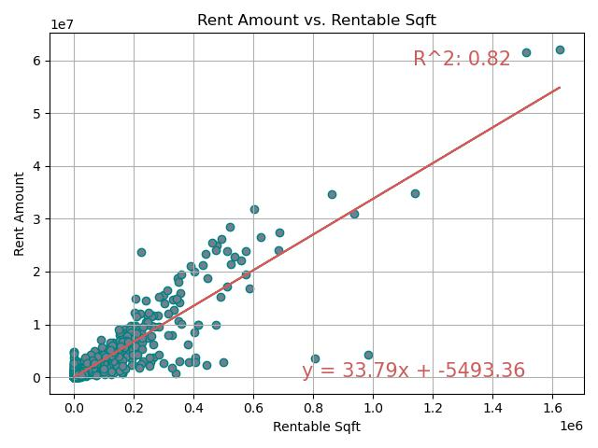
What are the correlations, if any, between rent amount and rentable ft² of unit leased?
The R² value of 0.82 indicates a strong positive correlation
Opportunity!
Notes:
Ally
(First portion is inside slide- continue on after the bolded section!)
The R² value of 0.82 indicates a strong positive correlation, meaning that as rentable square footage increases, the rent amount also tends to increase.
Again, we might consider removing the outliers to see how it changes the R² value.
Opportunity: Focus on optimizing and fully utilizing larger properties. Vacant or underutilized spaces in large properties could be leased to increase revenue.

Slide 13
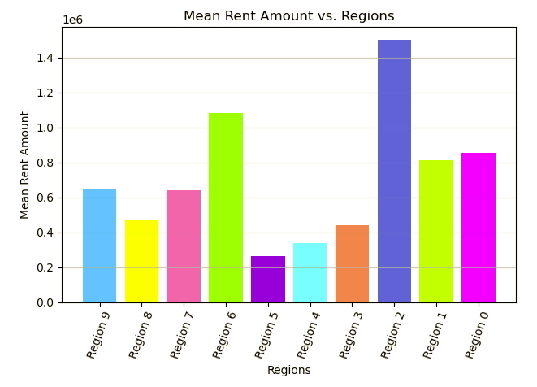
What are the correlations, if any, between ZIP code and rent of unit leased?
https://facts.usps.com/42000-zip-codes/
Region 2 has the highest mean rent, while Regions 5 and 4 appear to have the lowest.
This suggests significant regional differences in mean rent values.
Opportunity!
Notes:
Ally
Region 2 has the highest mean rent, while Regions 3 and 4 appear to have the lowest.
Adding in reference states when speaking on regions
This suggests significant regional differences in mean rent values.
Opportunity: Investigate why Region 6 is performing well. Are there high-demand properties or effective leasing practices?

Slide 14
Our Objectives
Government Efficiency
Space Management
Cost Savings
Transparency & Accountability
Where, in the US, are the most government leased properties?
What if, any, are the correlations between:
rent amount and usable ft²?
usable and rentable ft²?
rent amount and parking spaces?
ZIP code and length of lease?
rent amount and ft² of unit leased?
ZIP code and rent of unit leased?
Notes:
Erica
Government Efficiency:
Analyze and optimize government property usage.
Reduce costs associated with owned and leased properties.
Space Management:
Help federal agencies improve space allocation and resource utilization.
Identify underutilized or surplus properties for better reallocation.
Cost Savings:
Evaluate lease versus ownership costs to identify cost-saving opportunities.
Spot trends in lease renewals, terminations, and rent escalations.
Transparency & Accountability:
Provide transparency into federal property management for oversight and public trust.
Allow agencies and watchdogs to track government spending on real estate.

Slide 15
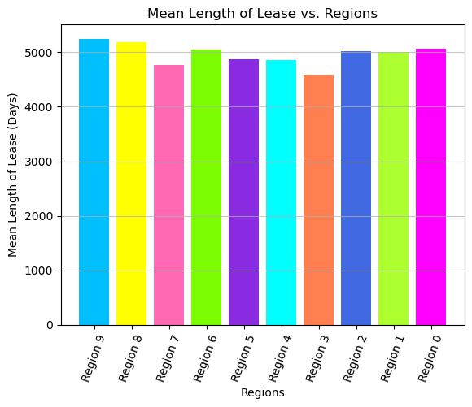
Summary Recommendations
1
2
Maximize Rentable Space:
Target Outliers
3
4
Reevaluate Parking:
Lease Optimization:
Notes:
Erica
Maximize Rentable Space: Renovate underutilized buildings to improve rentable square footage. Focus efforts on regions with lower mean rent values to increase property attractiveness.
Reevaluate Parking: Repurpose excessive parking spaces, especially where weak correlations indicate limited rent value impact. Parking areas could be leased or converted into alternative revenue-generating spaces.
Target Outliers: Investigate properties with unusually high or low rent, space utilization, or parking counts. Address inefficiencies or high costs tied to these anomalies.
Lease Optimization: Analyze lease lengths (e.g., Regions 3 and 4) to determine if renegotiations or shorter lease terms could improve returns.

Slide 16
Citations
General Services Administration. (2025, January 4). Real Estate across the United States (REXUS) (lease). Catalog. https://catalog.data.gov/dataset/real-estate-across-the-united-states-rexus-lease
https://facts.usps.com/42000-zip-codes/
Notes:
Erica

